Slide 1
Get started with AI Builder
Notes:
Link: https://docs.microsoft.com/en-us/learn/modules/get-started-with-ai-builder/

Slide 2
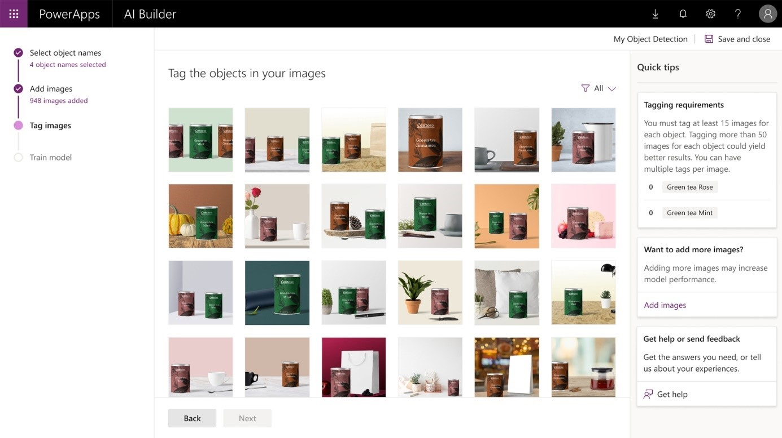
What you can do with AI Builder
You can use AI Builder to create custom AI models that suit the needs of your business, or you can choose from a selection of prebuilt models
Notes:
AI Builder is a Power Platform capability that helps you improve your business performance by automating processes and predicting outcomes. By using AI Builder, you can quickly bring AI to your apps and flows that connect to your business data that is stored in the underlying data platform (Microsoft Dataverse) or in various cloud data sources, such as SharePoint, OneDrive, or Azure.
AI models that you create in AI Builder can help provide intelligence to enhance your business. AI Builder simplifies the AI creation experience by giving people with any level of technical skill the ability to add AI capabilities to their apps and flows without writing code. AI Builder also provides prebuilt AI models, where you don't need to gather data to build and train the model. You can start to use the intelligence right away.
You can use AI Builder to create custom AI models that suit the needs of your business, or you can choose from a selection of prebuilt models. You can then use the AI from these models in your apps and workflows.
For example, with AI Builder you can:
Analyze text for classification, key phrases, language, and sentiment.
Predict whether something will happen.
Process business card information.
Process text from images.
Read and save information from standard documents.
Recognize and count items in images.
Analyze text for classification, key phrases, language, and sentiment.
Predict whether something will happen.
Process business card information.
Process text from images.
Read and save information from standard documents.
Recognize and count items in images.
A common use of AI Builder is to automate processes. The following examples can help you think about how you can use AI in your business:
Invoice processing - Companies often receive invoices in large quantities and from a variety of sources, such as mail, fax, email, or in person. Processing these documents and manually entering them into your database can take considerable time. By using AI to extract the text, key/value pairs, and tables from your documents, you can create workflows to automatically pipe the information into your database. You can even create an app to review the information.
Text analysis - Businesses today are collecting more data than ever before. Whether it's from survey responses, product reviews, user feedback, or support emails, generating the proper insights is important to understanding your business and your customers. By using AI to analyze text, you can identify customer feedback that contains negative sentiment or certain key phrases. Use AI to identify problems and then trigger the necessary workflows to take action.
Invoice processing - Companies often receive invoices in large quantities and from a variety of sources, such as mail, fax, email, or in person. Processing these documents and manually entering them into your database can take considerable time. By using AI to extract the text, key/value pairs, and tables from your documents, you can create workflows to automatically pipe the information into your database. You can even create an app to review the information.
Text analysis - Businesses today are collecting more data than ever before. Whether it's from survey responses, product reviews, user feedback, or support emails, generating the proper insights is important to understanding your business and your customers. By using AI to analyze text, you can identify customer feedback that contains negative sentiment or certain key phrases. Use AI to identify problems and then trigger the necessary workflows to take action.

Slide 3
What can you do with AI Builder?
Analyze text for classification, key phrases, language, and sentiment
Predict whether something will happen
Process business card information
Process text from images
Read and save information from standard documents
Recognize and count items in images
Notes:
AI Builder is a Power Platform capability that helps you improve your business performance by automating processes and predicting outcomes. By using AI Builder, you can quickly bring AI to your apps and flows that connect to your business data that is stored in the underlying data platform (Dataverse) or in various cloud data sources, such as SharePoint, OneDrive, or Azure.
AI models that you create in AI Builder can help provide intelligence to enhance your business. AI Builder simplifies the AI creation experience by giving people with any level of technical skill the ability to add AI capabilities to their apps and flows without writing code. AI Builder also provides prebuilt AI models, where you don't need to gather data to build and train the model. You can start to use the intelligence right away.

Slide 4
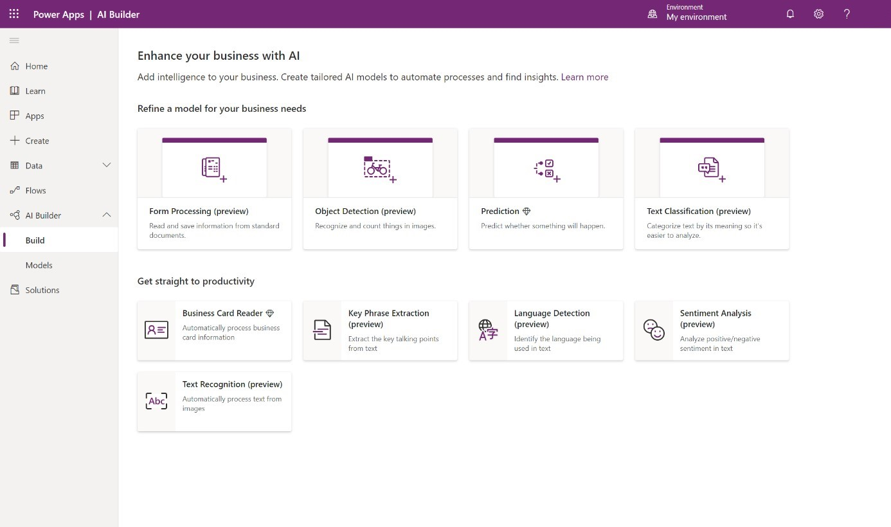
Where you can use AI Builder
You can access AI Builder within Power Apps and Power Automate
Notes:
You can access AI Builder within Power Apps and Power Automate.
Two available areas under AI Builder in the left side menu are:
Build - Where you create and get started by using AI models.
Models - Where your created and shared models reside.
Build - Where you create and get started by using AI models.
Models - Where your created and shared models reside.

Slide 5
Exercise: Create your first model
Follow the exercise steps in your student manual in Lesson 1
Notes:
Guided experience

Slide 6

Choose an AI capability

Slide 7
Choose a model
AI Builder comes with a wide variety of models to enhance your apps and business processes
Notes:
AI Builder comes with a wide variety of models to enhance your apps and business processes.
Sign in to Power Apps or Power Automate and select AI Builder > Build on the left menu. Each tile represents a different AI capability that you can bring to your business.
Select any tile.

Slide 8
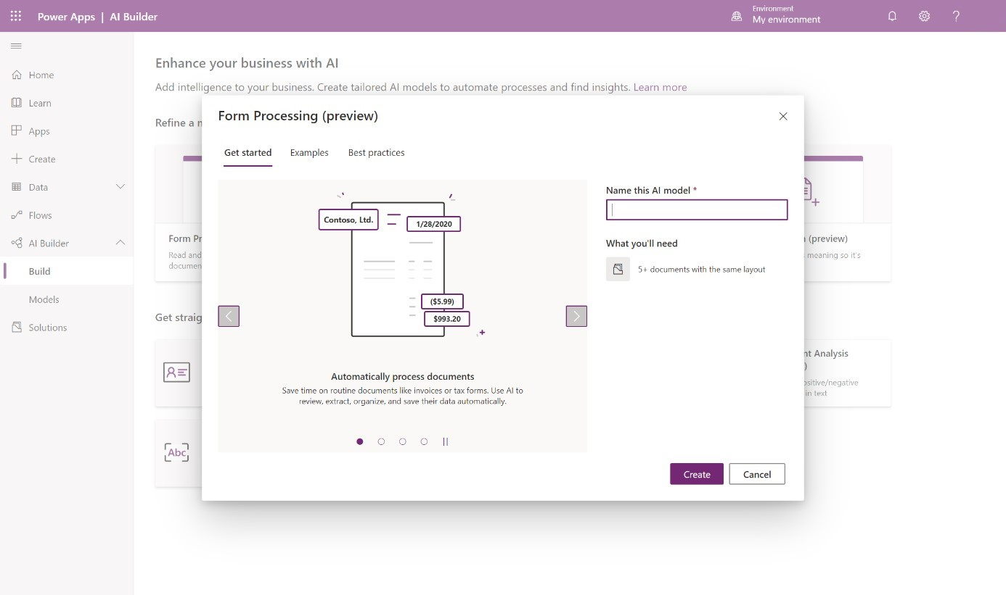
Learn about the model
Each AI Builder model has an introductory experience where you can learn more about the model
Notes:
Each AI Builder model has an introductory experience where you can learn more about the model.
For those models that require customization, AI Builder provides a summary of the steps that you need to take and what you need to get started. The Examples tab also includes examples of how you can use the model.
For prebuilt models, AI Builder includes best practices on how to use them and buttons that you can select to get started using them right away.

Slide 9
Select a model type
Sign in to Power Apps or Power Automate and select AI Builder > Build on the left menu:
Form processing
Object detection
Prediction
Text classification
Notes:
Sign in to Power Apps or Power Automate and select AI Builder > Build on the left menu.
The two classes of model are:
Models that require customization before they can be used
Models that are prebuilt and can be used right away
Prebuilt models have already been created for you and can be used right away in your apps and flows. No prior work is needed to create the model.
The following sections explore what you can do with the models that you customize.
Select the tile for one of the following model types:
Form processing
Object detection
Prediction
Text classification
Form processing
Object detection
Prediction
Text classification
Make sure that you have everything you need to create your model, as listed on the Get started tab. You can also use sample datato create any of these models.
Enter a name for your model in the Name this AI model column.
Select Create.
Enter a name for your model in the Name this AI model column.
Select Create.

Slide 10

Ways to use your models

Slide 11
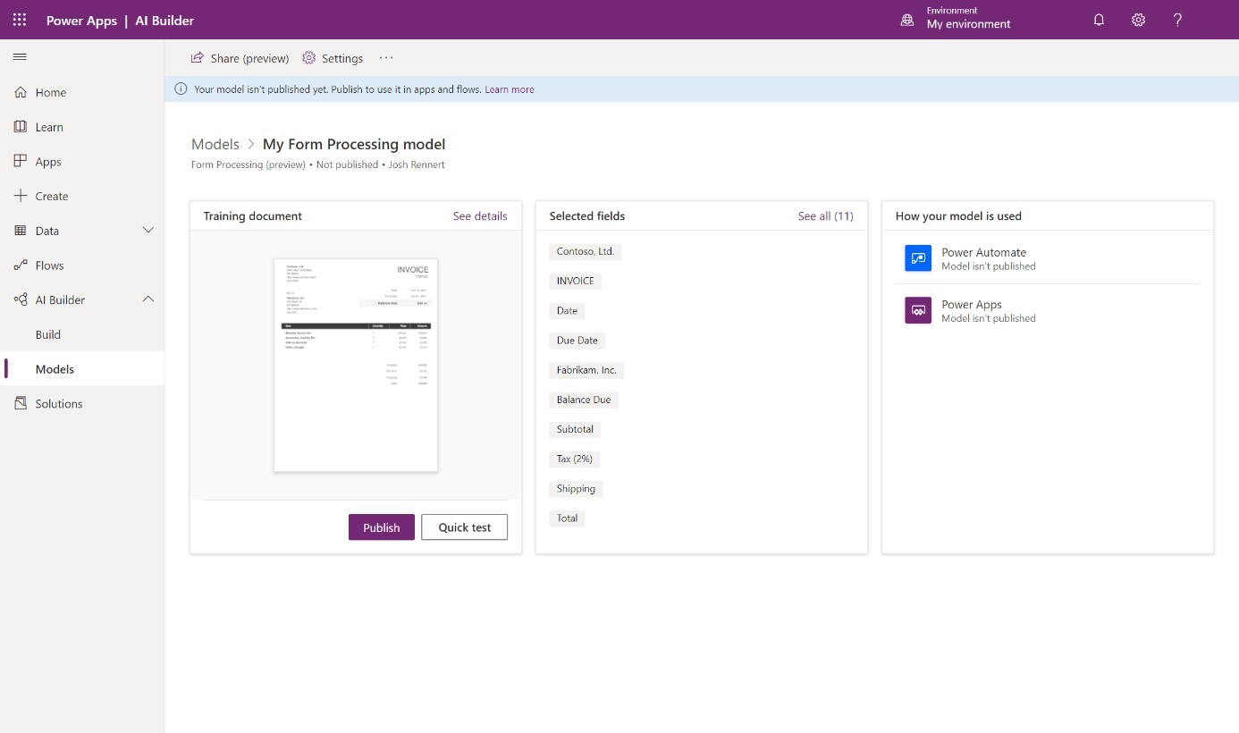
View your model details
After your model has completed training, you can view important details about your newly trained model on a details page for that model
Notes:
After your model has completed training, you can view important details about your newly trained model on a details page for that model. The information might vary depending on the model type.
On the model details page, you can see the customizations that you made to train your model. In some cases, it shows additional insights on the training performance. Some model types give you the opportunity to quick test your model to see it live in action.
You can access this page at any time from the left menu by selecting AI Builder > Models and then searching for your model name.

Slide 12
Publish your model
Your model can’t be used until it is published:
As a component in an app
As an action in a flow
As new data in your database
Notes:
Your model can't be used until it is published. If you are satisfied with your model, select Publish to make it available.
Three main ways that you can use your model are:
As a component in an app
As an action in a flow
As new data in your database
When your model is published, select Use model to see a list of the available actions that you can take to use your model.

Slide 13
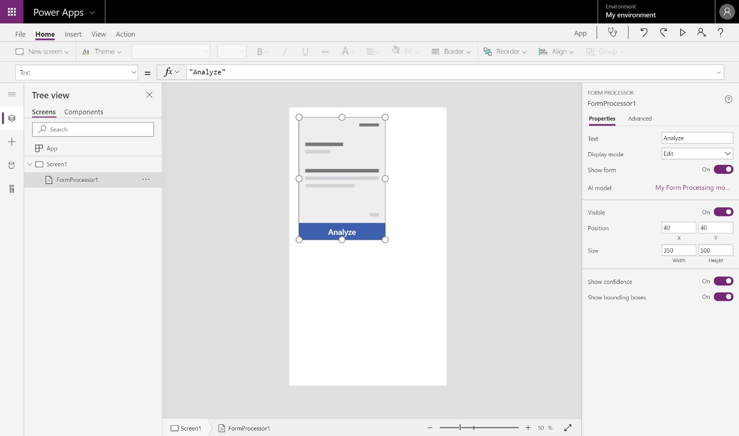
Use your model in an app
In the Use your model pane, select Create new app, which appears if your model type supports it
Notes:
In the Use your model pane, select Create new app, which appears if your model type supports it.
This selection redirects you to the canvas app creation experience, with the AI Builder component already added to your canvas and your model automatically linked to the component.

Slide 14
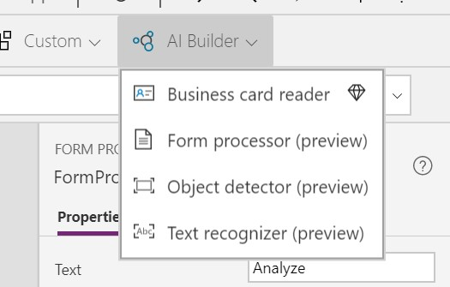
Use your model in an app
You can add AI Builder components to your existing apps at any time by selecting the Insert tab and then selecting the component from the AI Builder menu
Notes:
You can add AI Builder components to your existing apps at any time by selecting the Insert tab and then selecting the component from the AI Builder menu.

Slide 15
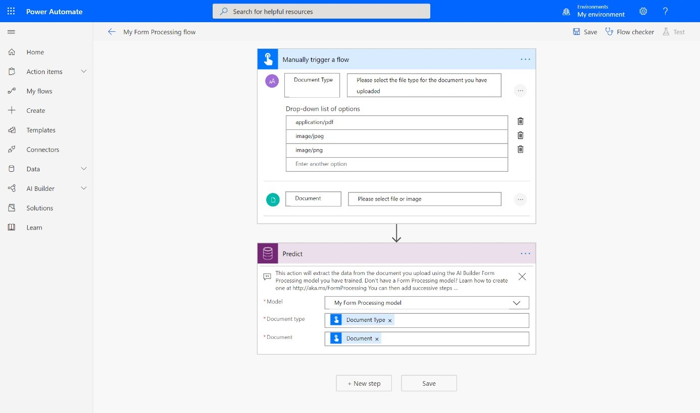
Use your model in a flow
In the Use your model pane, select Create new flow, which appears if your model type supports it
Notes:
In the Use your model pane, select Create new flow, which appears if your model type supports it.
This selection redirects you to the flow template page in Power Automate. Confirm the connections and then select Continue.
In the flow creation experience, you'll find the AI Builder action already added to your flow and your model automatically linked to the action.
You can add the AI Builder action to solution-aware flowsby searching for the Predict action under Dataverse (current environment) and then selecting your model name from the Model drop-down menu.

Slide 16
Use your model in your database
Some model types write the intelligence back to your database, so you can use it in your data views in Power Apps or Power BI
Notes:
Some model types write the intelligence back to your database, so you can use it in your data views in Power Apps or Power BI.
After you have published your model, some model types automatically begin scheduling the model to write data back to your database by default. For others, you can customize the scheduling. In the Use your model pane, select Set run schedule to define the frequency. This option appears when the model supports it.
You have now learned the various ways that you can use your AI Builder models in Power Apps and Power Automate.

Slide 17
Create a chatbot with Power Virtual Agents and Dataverse for Teams

Slide 18
Introduction
Employees who have quick access to information make better decisions, reduce errors, and save money.
Create a chatbot.
Use the chatbot to call Microsoft Power Automate actions to retrieve data from Dataverse for Teams.
Publish the chatbot to your team or the whole company.
Notes:
Employees who have quick access to information make better decisions, reduce errors, and save money. Chatbots create a personalized experience that simplifies how employees get information. Microsoft Power Virtual Agents and Microsoft Dataverse for Teams create intelligent chatbots to quickly respond to employee needs without building high-code solutions.
By the end of this course, you will be able to:
Create a chatbot.
Use the chatbot to call Microsoft Power Automate actions to retrieve data from Dataverse for Teams.
Publish the chatbot to your team or the whole company.
This module goes through the process of creating, editing, and then publishing a chatbot that provides contact information for an event planning team.

Slide 19
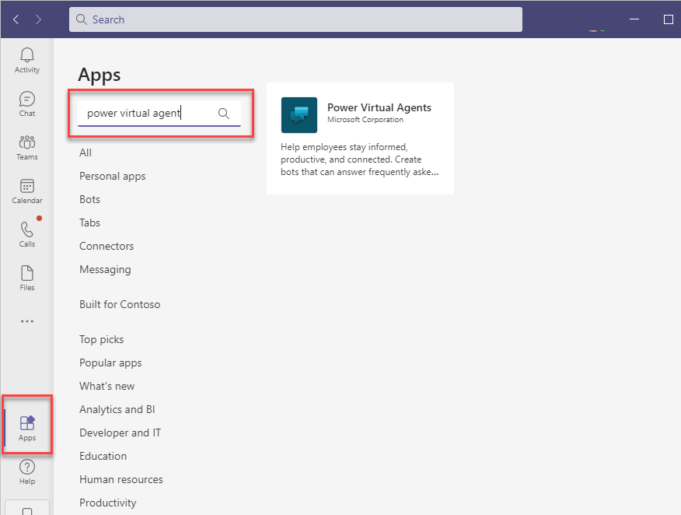
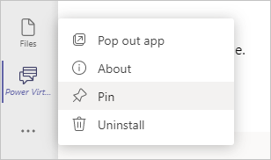
Create your first chatbot
To create chatbots (also referred to as bots), first install the Power Virtual Agents app in Microsoft Teams.
Create and edit chatbots.
Test the chatbot to see how well it works.
Publish the chatbot to your team or organization.
Review the bot's performance over time, note the questions that are asked, and assess how well it's answering questions.
Notes:
To create chatbots (also referred to as bots), first install the Power Virtual Agents app in Microsoft Teams. Power Virtual Agents allows you to:
Create and edit chatbots.
Test the chatbot to see how well it works.
Publish the chatbot to your team or organization.
Review the bot's performance over time, note the questions that are asked, and assess how well it's answering questions.
To install Power Virtual Agents for Teams:
Open Teams and then select Apps from the left navigation bar.
Enter Power Virtual Agents in the search box and then select it from the search results.
[!div class="mx-imgBorder"] Screenshot of the Apps feature in Teams with Power Virtual Agents search.
3. Select Add to install the Power Virtual Agents app in Teams.
[!div class="mx-imgBorder"] Screenshot of the Apps feature in Teams with Power Virtual Agents search.
[!NOTE] Pin the Power Virtual Agents app in Teams for easier access. Select the app by selecting the ellipsis (...) and then selecting Power Virtual Agents. Right-click the Power Virtual Agents icon and select Pin.
[!div class="mx-imgBorder"] Screenshot of the Pin feature for Power Virtual Agents.

Slide 20
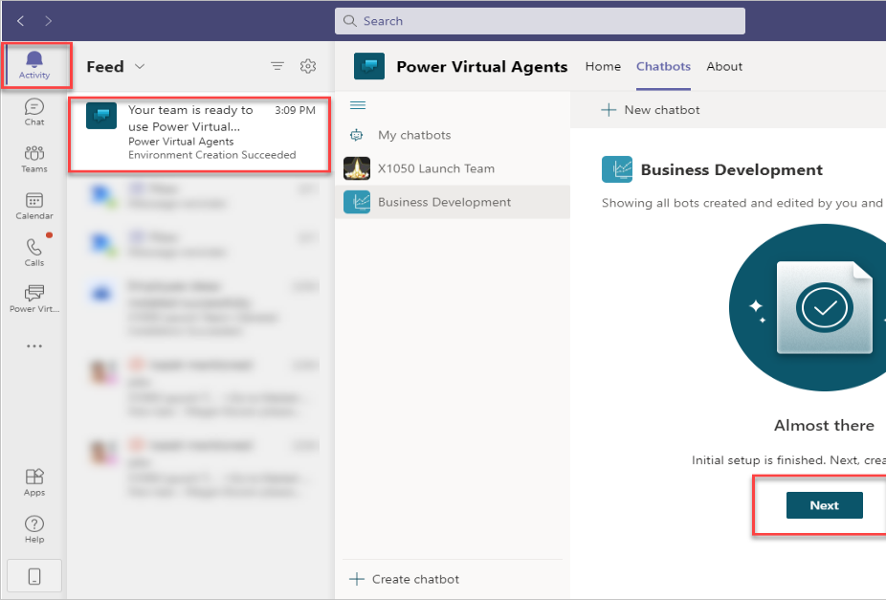
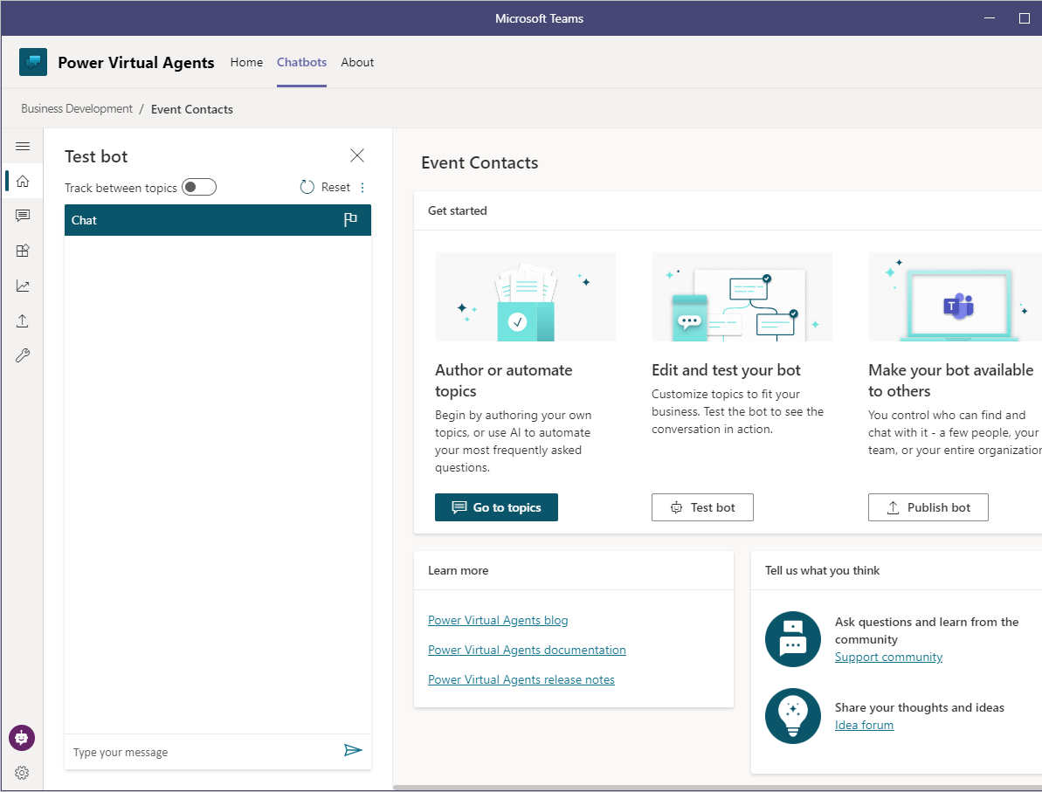
Create a new chatbot
Notes:
To create a new chatbot, follow these steps:
Open the Power Virtual Agents for Teams app.
Select Start now.
Select the team to own and manage your chatbot from the drop-down list and then select Continue.
When you are creating a new chatbot, team owners and the bot creator have read/write access by default. Team members only have read access to the chatbot.
If this is your first time creating a chatbot or Power Apps application in the team, you will receive a notification that the process will be slightly longer than usual while the system sets up. Select Close to continue and then wait a few minutes for Teams to notify you that the chatbot is ready. After setup has completed, open the notification under Activity and then select Next.
[!div class="mx-imgBorder"] Screenshot of the setup is complete notification.
Provide a Name and select the Language for the chatbot. For this example, use Event Contacts for the name. After you have set the chatbot's language, it can't be changed.
Select Create to complete creating a new chatbot.
[!div class="mx-imgBorder"] Screenshot of the setup is complete notification.
From the Power Virtual Agents editor, you can manage topics, edit and test your chatbot, and then publish it to the rest of the team or the entire organization. Topics are how chatbot conversations transpire and they are covered in the next section.
[!div class="mx-imgBorder"] Screenshot of the test bot, edit, and manage topics features.

Slide 21
Create and modify topics
In Power Virtual Agents, chatbot conversations are defined by topics.
Trigger phrases - The chatbot needs to detect when the user asks a question that it knows how to respond to. The trigger phases are the phrases, keywords, and questions that the user is likely to enter. We recommend that you have 5 to 10 trigger phrases of common ways that your users would request help on the topic.
Conversation nodes - When the chatbot has a question, it needs to know how to handle the request. Conversation nodes define how the chatbot responds and if actions are required.
The first four topics are sample user topics that demonstrate various ways of using topics to create conversations.
The remaining topics are system topics that are likely needed during a chatbot conversation.
Notes:
In Power Virtual Agents, chatbot conversations are defined by topics. With topics, you can define and control the way that the conversation evolves.
Two types of topics are:
Trigger phrases - The chatbot needs to detect when the user asks a question that it knows how to respond to. The trigger phases are the phrases, keywords, and questions that the user is likely to enter. We recommend that you have 5 to 10 trigger phrases of common ways that your users would request help on the topic.
Conversation nodes - When the chatbot has a question, it needs to know how to handle the request. Conversation nodes define how the chatbot responds and if actions are required.
To view and edit topics in your chatbot, select Topics from the left column in the Power Virtual Agents editor. Many topics are automatically created for a chatbot:
The first four topics are sample user topics that demonstrate various ways of using topics to create conversations.
The remaining topics are system topics that are likely needed during a chatbot conversation.

Slide 22
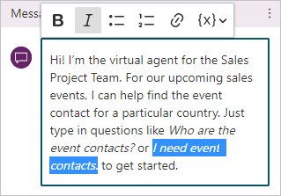
Change the greeting system topic
System topics improve the usability of your chatbot with prebuilt topics to handle greeting, escalating, starting over, and saying goodbye.
Conversation node | Description
Ask a question | Have the chatbot ask a question and get a response from the user
Add a condition | Add branching logic
Call an action | Call Power Automate flows
Show a message | Have the chatbot respond to the user
End with survey | When the conversation ends, a survey appears
Notes:
System topics improve the usability of your chatbot with prebuilt topics to handle greeting, escalating, starting over, and saying goodbye. Editing these topics allows you to further personalize the chatbot for your users and organization.
The Greeting system topic provides a welcome message for the user. It's important to clearly define what the bot is meant to do, which will set expectations with the user.
Select the Greeting system topic and then select Go to authoring canvas.
The authoring canvas is where you design the topic's conversation path by using conversation nodes. Conversation nodes determine how a chatbot responds and what actions it might have to take. The five different types of conversation nodes that you can add are described in the following table.
Conversation node Description
Ask a question
Have the chatbot ask a question and get a response from the user
Add a condition
Add branching logic
Call an action
Call Power Automate flows
Show a message
Have the chatbot respond to the user
End with survey
When the conversation ends, a survey appears
All chatbots start with the trigger phrases and a message conversation node.
The text in the first message node doesn't match the purpose of your bot. Change the text to the following example. Use the text editing controls in the message node to have the questions appear in italic font.
Hi! I'm the virtual agent for the Sales Project Team. For our upcoming sales events, I can help find the event contact for a particular country. Just type in questions like Who are the event contacts? or I need event contacts. to get started.
[!div class="mx-imgBorder"] Screenshot of the message node with text editing controls used.
Save the settings by selecting Save.
Exit the topic authoring canvas by selecting Back.
[!div class="mx-imgBorder"] Screenshot of the save button and the back button.
[Table was here]
[!div class="mx-imgBorder"] Screenshot of the message node with text editing controls used.
[!div class="mx-imgBorder"] Screenshot of the save button and the back button.

Slide 23
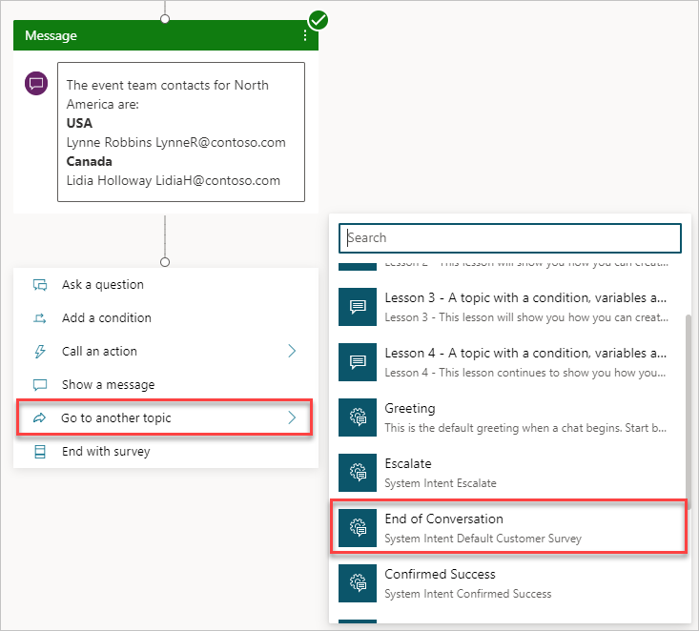
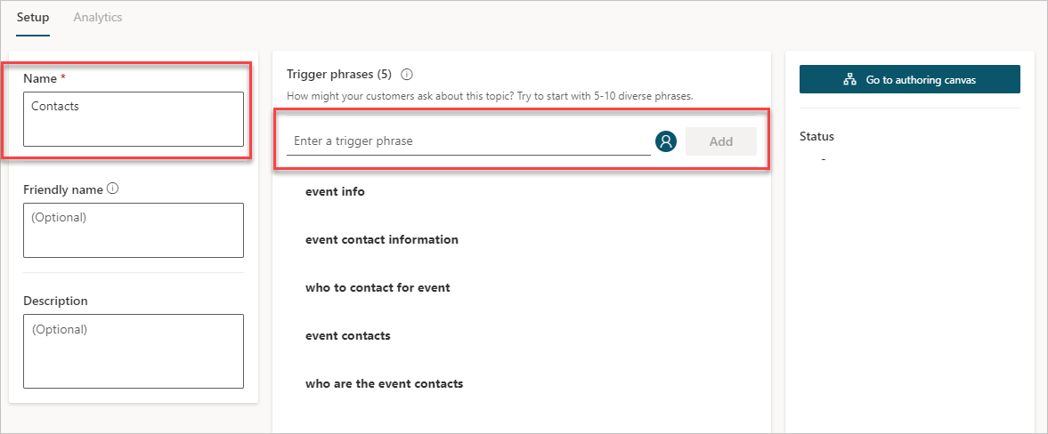
Create a topic
For the Event Contacts chatbot, you want the chatbot to respond to the question, "Who are the event contacts?" From the Topics page in Power Virtual Agents in Teams:
Notes:
For the Event Contacts chatbot, you want the chatbot to respond to the question, "Who are the event contacts?" From the Topics page in Power Virtual Agents in Teams:
Select + New topic.
Enter Contacts for the Name.
Enter the following Trigger phrases. Select Add between each one.
who are the event contacts
event contacts
who to contact for the event
event contact information
event info
[!div class="mx-imgBorder"] Screenshot of the Name field and the Enter a trigger phrase field.
Select Save topic in the upper-right corner to add the topic to the list.
Select Go to authoring canvas. In the Message node, enter the following information. Use the editing options in the text box to apply bold formatting to the country names.
The event team contacts for North America are:
USA Lynne Robbins LynneR@contoso.com
Canada Lidia Holloway Lidia@contoso.com
[!div class="mx-imgBorder"] Screenshot of the trigger phrases and message.
Select the plus + symbol under the Message node to add another conversation node.
Select Go to another topic > End of Conversation.
The End of Conversation option is a system topic on how to end the conversation. This system topic asks the user about the accuracy of the results and to rate their experience. All system topics can be edited to customize the experience in the Topics screen.
[!div class="mx-imgBorder"] Screenshot of Go to another topic and End of Conversation features.
Select Save.
Select Test bot and a new pane will appear for testing the chatbot. Enter questions that contain one of the trigger phrases to observe how the bot responds.
[!div class="mx-imgBorder"] Screenshot of the Test bot button with trigger phrases.
[!div class="mx-imgBorder"] Screenshot of the Name field and the Enter a trigger phrase field.
[!div class="mx-imgBorder"] Screenshot of the trigger phrases and message.
[!div class="mx-imgBorder"] Screenshot of Go to another topic and End of Conversation features.
[!div class="mx-imgBorder"] Screenshot of the Test bot button with trigger phrases.
Congratulations, you have created your first chatbot by using Power Virtual Agents for Teams. The next unit expands the chatbot to use inputs, variables, and conditions.
For the Event Contacts chatbot, you want the chatbot to respond to the question, "Who are the event contacts?" From the Topics page in Power Virtual Agents in Teams:

Slide 24
Create your first chatbot
Notes:
Demo the steps in the following learning path. Students have all the steps in their manual and can follow along
https://docs.microsoft.com/en-us/learn/modules/create-chatbot-power-virtual-agents-dataverse-teams/

